Slide 1
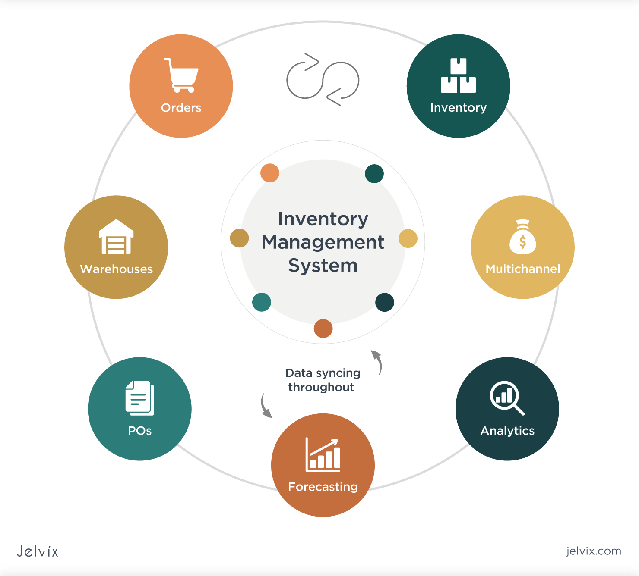
Presentation Topic: Inventory Management System
Group Members :
1. SM Tanvir Hasan Anik 2. Safaeat Molla 3. Kaniz Fatema Keya
4. Nazmul Hasan

Slide 2
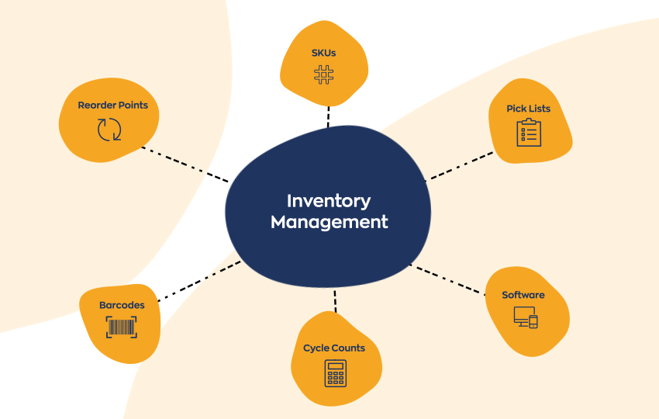
Introduction: A web application that will help a business ordering, storing, using, and selling a company’s product. This will ease the work for a manager of a business to maintain stocks according to demand, supplies and budget.

Slide 3
Inventory Management System
Problem statement: The existing system has some flaws such as they lack some analytical features and the application on the market are not so easy to use for all type of users. That is why we have solved these problems in our new system
Goal of the project: Inventory management tracks the flow of goods from manufacturer to warehouse to consumer. It directly affects customer relationship. Effective inventory management maintains balance between customer satisfaction and company profits ensuring there are enough products for the company to sell without too much spending money. Our web application “Inventory manager” promises to achieve it.

Slide 4
Inventory Management System
Objectives:
User friendly Interface/ Easier to operate.
Return and replacement system
Purchase and sale history with date time
Sorting demanding products analysis
Cash flow analysis of the inventory
Objectives

Slide 5
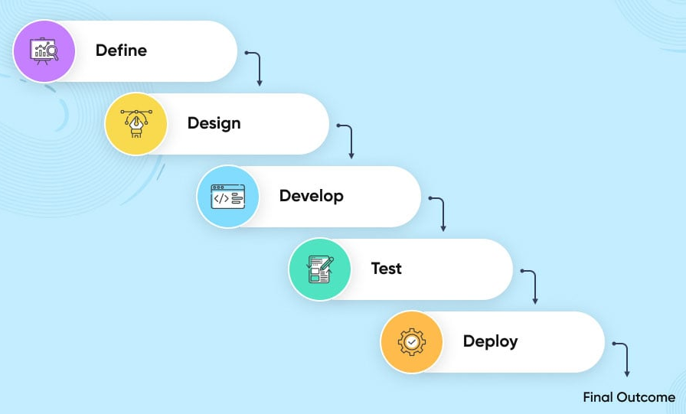
Inventory Management System
workflow:
Objectives

Slide 6
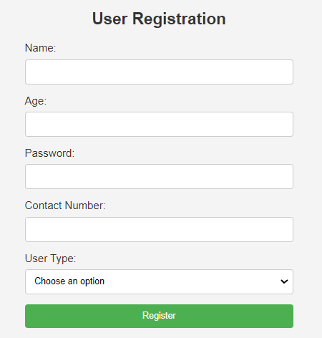
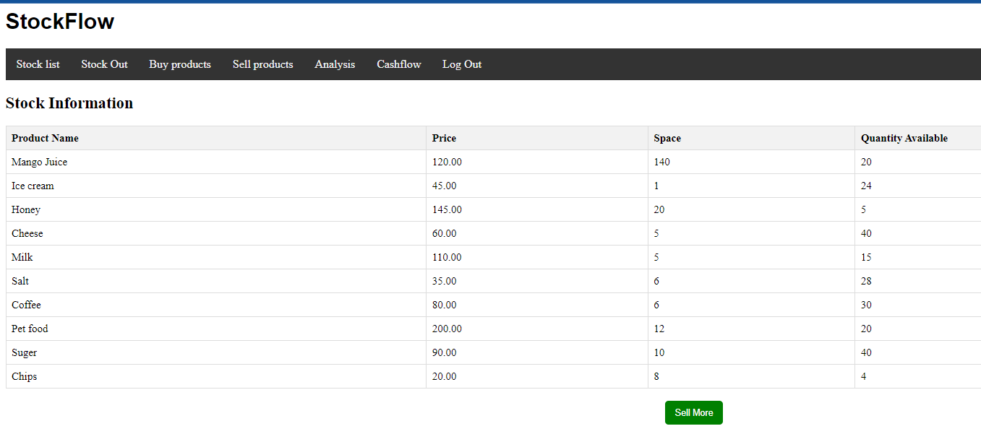
Inventory Management System
UI/UX:
Objectives

Slide 7
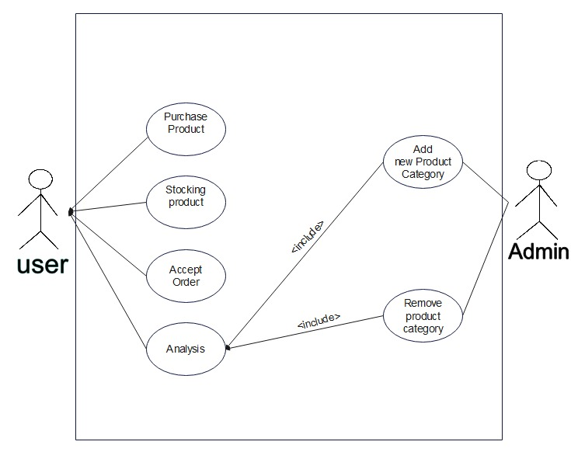
Use Case Diagram:

Slide 8
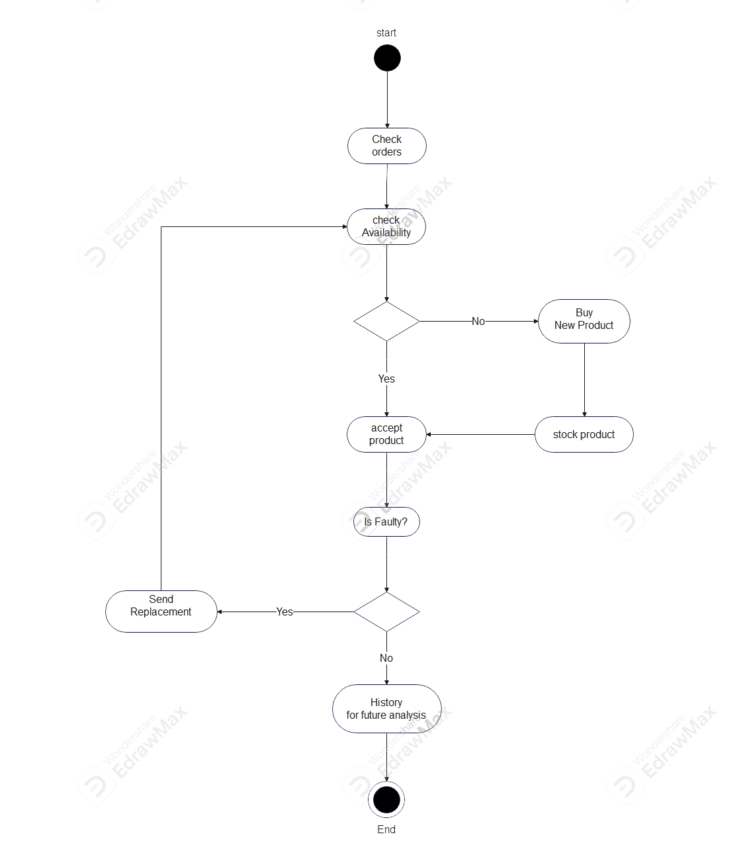
Activity Diagram

Slide 9
Inventory Management System
Types of stakeholders: There are 3 types of stake holders
1.Admin (Shop owner)
2.User (Manager,customer) 3.Developer
Functionality Grouping:
Admin: Admin will be able to add new product category with space and cost required per piece and remove current product categories.
User: The user/manager of the company will be able to use all the features of the application ex. purchasing, selling analyzing stocks etc.
Developer: Developers will maintain and develop the application. Bug fixing, new features etc.

Slide 10
Adding product to inventory
We can have the following features in the buy product page:
List of products to acquire
Choosing quantity of the product
Total cost of the chosen products
Total space occupied by the chosen products

Slide 11
Inventory List
We can have the following features in the inventory page:
List of products in inventory
Set Total space of the storage
Total space occupied by the products and remaining space
Discard product from inventory

Slide 12
Sell products
We can have the following features in the sell product page:
choose products that we want to sell
See the total list of products sold

Slide 13
Analysis
We can have the following features in the Analysis page:
Sort most demanded products according to past orders to help forecasting
View overall cash flow analysis to understand current business state

Slide 14
Thank You

